Slide 1
Policy Briefs in Public Health
Alejandro Beltran
Logan Blair
School of Government and Public Policy, UA

Slide 2
Outline
What is public policy?
Who participates in policy?
When is public policy effective and how to tell?
Purpose of a policy brief
How to write a policy brief
Example of a policy brief in public health

Slide 3
What is public policy?
Alejandro Beltran
Strategies to achieve an objective that aligns with your beliefs and values.
Policy comes in many different forms
Rules
Programs
Examples from health domain?
Mandatory vaccination for kindergarteners
Flu vaccine awareness campaigns

Slide 4
When does a health problem become public?
Example: Childhood obesity
What are the causes of obesity?
What are the impacts?
Private? Why public?
Who decides?
Who benefits?

Slide 5
Who Participates in Policy?
Citizens
Government
Private industry
Media
Public Health Experts
Interest Groups
Can you identify their agendas or motivations?
Who wins / loses?

Slide 6
Once the problem is public… what is the best strategy to follow?
Direct
“Sugar “ tax (consumers)
Industry tax
Ban junk food commercials during children’s programming
Ban sugar products in schools
Health care treatments
Indirect
Campaigns
Caloric labels
Who wins / loses?

Slide 7
Policy Efficacy
Subjective - depends on audience -- what is best? For who?
Childhood obesity example
How do we know it was effective?
Considerations:
Measurement
Outcome
Cost - benefit
Ethical ?

Slide 8
Logan Blair
Policy Briefs
Purpose and Process

Slide 9
Consider the following
An elected official in a rural Indonesia is concerned with health-related declines in school attendance. They overheard that intestinal worms were the culprit of a similar decline in other parts of the world. Low on time, and wary of the complexity of the topic, they seek you out to explain the effectiveness, economics, and possible approaches to treatment.
How would you respond to the official?

Slide 10
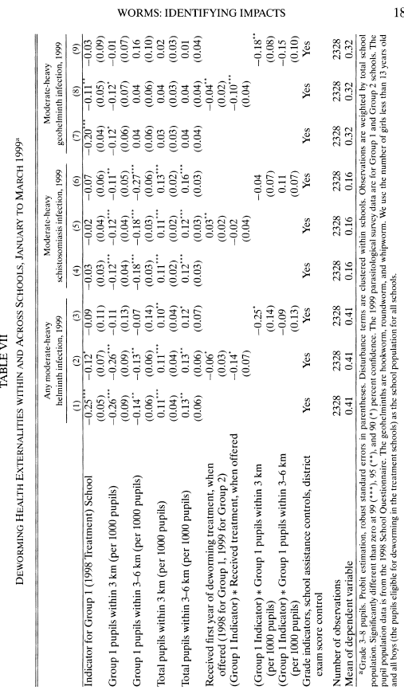

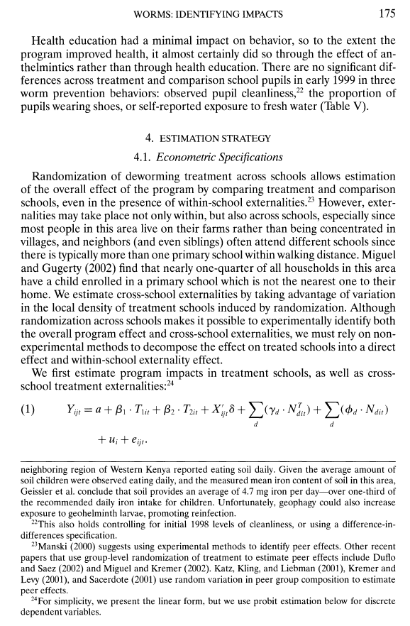
Traditional Academic Response

Slide 11
Purpose of Policy Brief
Tool for sharing information with non-specialists
Diagnostic tool - summary previous efforts
Help reader decide what to do by emphasizing likely outcome

Slide 12

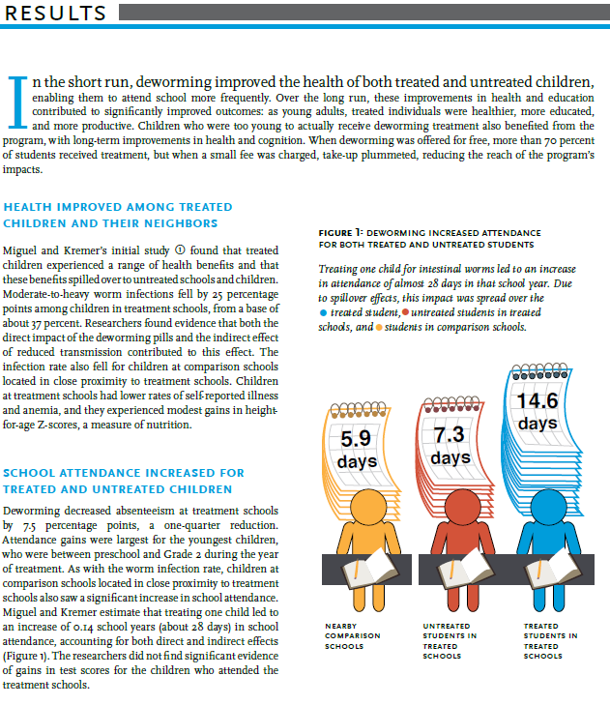
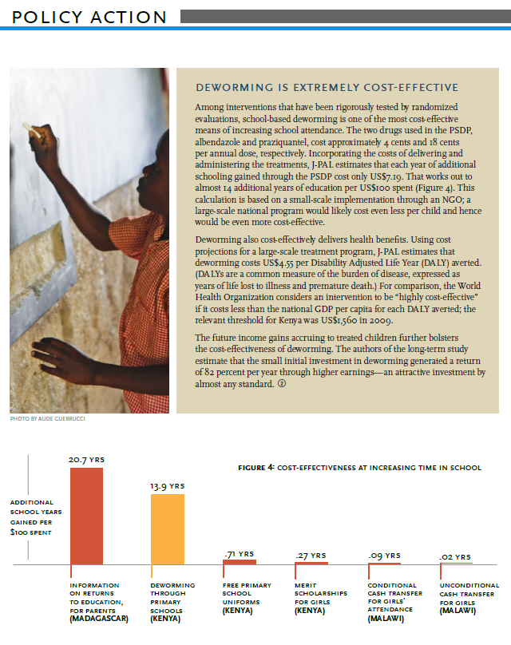
Same Information, Different Format

Slide 13
Planning a Policy Brief
Audience
Who’s reading the brief?
Large variation even among briefs
Public offical vs. conference vs. the voting public require different levels of detail (person/ school days), language (externality / affected neighbor).
Framing
What is the (narrow) problem?
What is the scope of the problem? Space? Time?
Who is affected by the problem (Stakeholders)?
Assign a face to policy—but careful not to exclude!

Slide 14
Writing the Brief
Stand-alone piece
Single topic
Concise (usually 2-4 pages)
Easy to read
Section titles
Graphics

Slide 15
Possible Components
Title
Executive Summary
Context/Scope
Policy Alternatives
Recommendations
Appendices
Sources

Slide 16
Possible Components
Title - quickly communicate content
Executive Summary
Context/Scope
Policy Alternatives
Recommendations
Appendices
Sources

Slide 17
Possible Components
Title - quickly communicate content
Executive Summary - 1-2 par., problem and proposal
Context/Scope
Policy Alternatives
Recommendations
Appendices
Sources

Slide 18
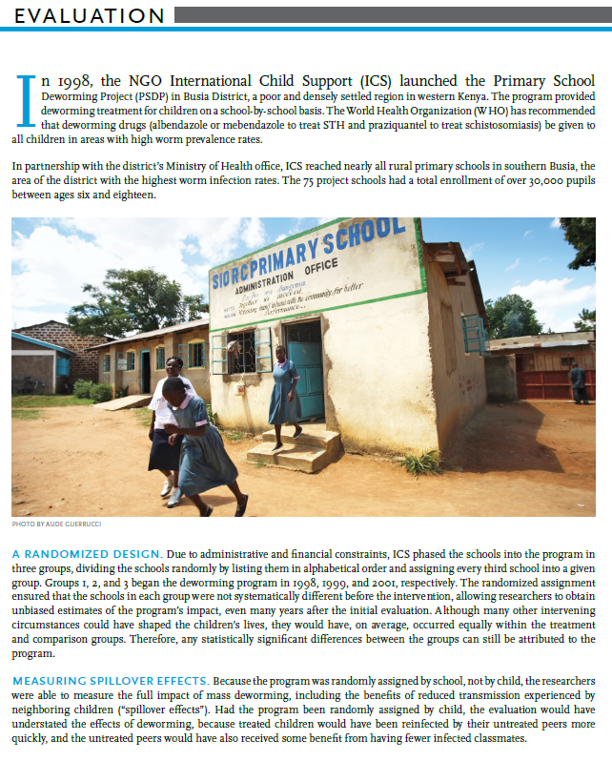
Possible Components
Title - quickly communicate content
Executive Summary - 1-2 par., problem and proposal
Context/Scope - importance, who is impacted
Policy Alternatives
Recommendations
Appendices
Sources

Slide 19
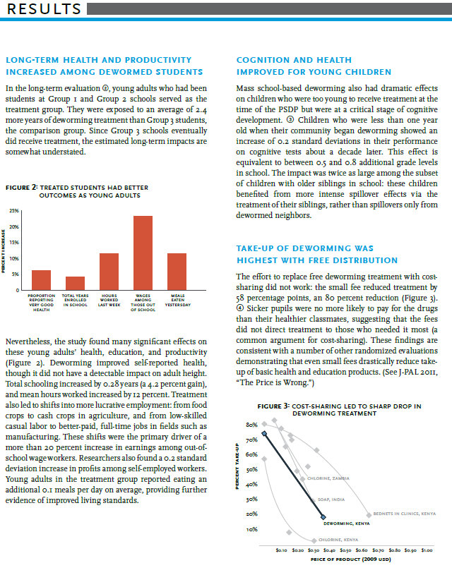
Possible Components
Title - quickly communicate content
Executive Summary - 1-2 par., problem and proposal
Context/Scope - importance, who is impacted
Policy Alternatives - explanation of concrete steps
Recommendations
Appendices
Sources

Slide 20
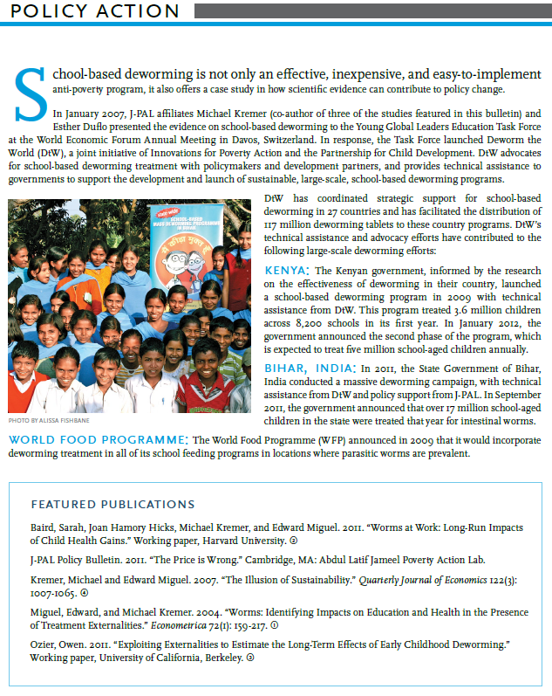
Possible Components
Title - quickly communicate content
Executive Summary - 1-2 par., problem and proposal
Context/Scope - importance, who is impacted
Policy Alternatives - explanation of concrete steps
Recommendations - suggest action
Appendices
Sources

Slide 21
Possible Components
Title - quickly communicate content
Executive Summary - 1-2 par., problem and proposal
Context/Scope - importance, who is impacted
Policy Alternatives - explanation of concrete steps
Recommendations - suggest action
Appendices - evidence and details
Sources

Slide 22
Resources
University of North Carolina, Writing Center http://writingcenter.unc.edu/policy-briefs/
International Development Research Centre https://www.idrc.ca/sites/default/files/idrcpolicybrieftoolkit.pdf
Jones and Bartlett Publishers, Student Resources http://www.jbpub.com/essentialpublichealth/skolnik/sampleFiles.aspx
Miguel, Edward, and Michael Kremer. "Worms: identifying impacts on education and health in the presence of treatment externalities." Econometrica 72.1 (2004): 159-217.
International Povery Action and J-PAL
https://www.poverty-action.org/publication/deworming-best-buy-development

Slide 23
Contact Information:
Alejandro Beltran
alejandrobeltran@email.arizona.edu
Logan Blair
blairlo@email.arizona.edu

